Slide 1
PUBLIC TRANSPORT AND OPTIMIZATON
Done by,
Nandhini P
Manjuladevi S
Swetha G
Chinnathai A
Guided by,
Vaitheki S

Slide 2
Content
Objective
Introduction
Public transport optimization using IOT
Problem description
System requirement
System design
Coding using python
Benefits and challenges
Conclusion

Slide 3
Objective
To develop a Smart system that could benefit RTC (Road Transport Corporation) as well as the passengers.
To develop a business model where operator can act as an Enterprise Service Provider.
To encourage the passenger to use public transport for commuting there by reducing traffic congestion, air pollution etc.
The main objective of public transportation optimization using IOT is to enhance the operational efficiency of transportation systems.
By deploying IOT sensors and devices, real-time data can be collected and analyzed to optimize routes, schedules, and resources, reducing delays and improving overall system performance

Slide 4
Introduction
The Internet of Things (IOT) refers to a vast network of interconnected devices that collect and exchange data via the internet.
Internet of Things (IOT) based public transportation optimization is a smart and innovative approach to improve the efficiency, safety, and overall quality of public transportation systems.
To implement these IOT-based optimizations, a robust network infrastructure, secure data handling practices, and collaboration among transportation authorities, technology providers, and data analysts are crucial.

Slide 5
Public transport optimization using IOT
Optimizing public transportation using IoT (Internet of Things) involves the use of sensors, data analysis, and smart technologies to enhance the efficiency, safety, and convenience of transit systems.
To implement these IoT-based optimizations, a robust network infrastructure, secure data handling practices, and collaboration among transportation authorities, technology providers, and data analysts are crucial.
This approach can lead to more efficient, reliable, and user-friendly public transportation systems

Slide 6
Problem description
As per RTA(Road Traffic Accident) records most of the public transport accidents are occurred by carrying heavy loads.
In our city our transports and roads are not maintained properly, because of this people may suffer.
Most of the popular routes are crowded during the festival and vacation period, people may endure by waiting for transport.
Waiting time for transport is extended due to heavy traffic.
Service distribution are not optimized by our people.

Slide 7
System requirement
Hardware requirement:
GPS tracker
Smart card for monitoring the transport
Software requirment:
Python in machine learning

Slide 8
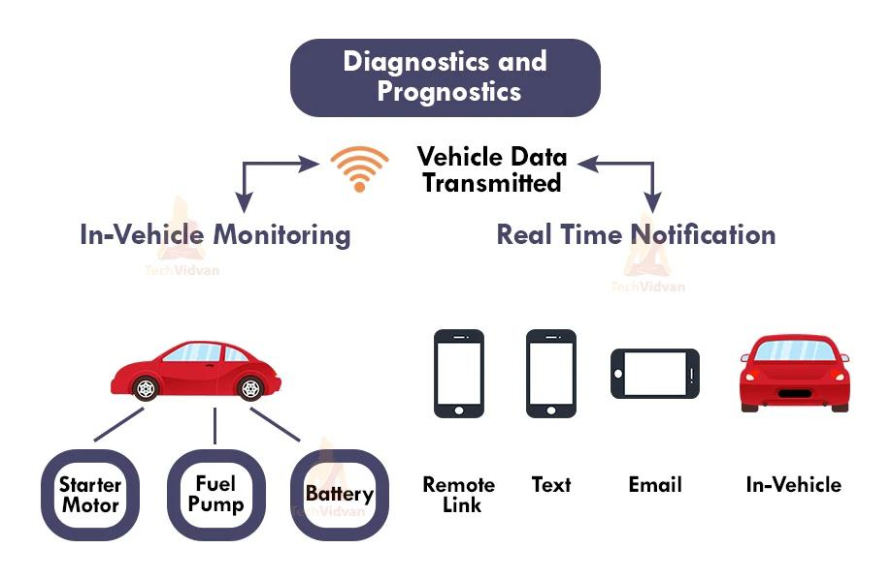

Slide 9
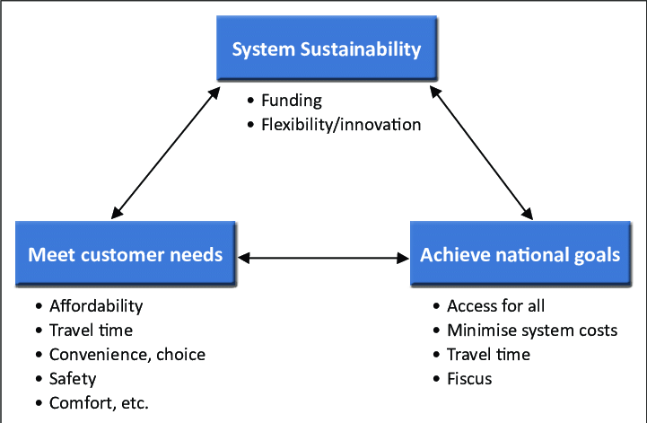
System design

Slide 10
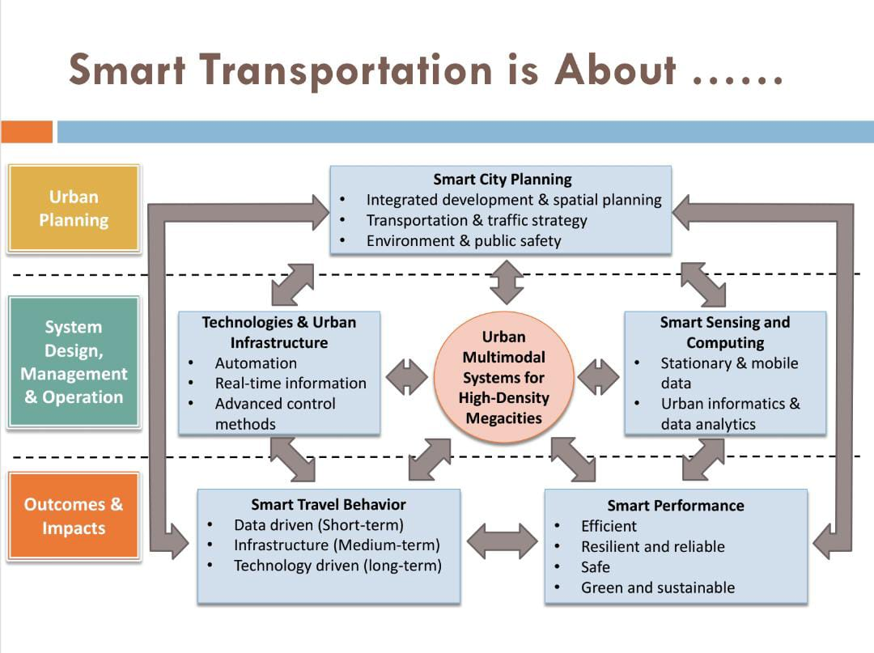

Slide 11
Coding for smart transport
const String PHONE = "+9188305848xx";
#define ignition_switch 4
#define ignition_sensor A0
//GSM Module RX pin to Arduino 3
//GSM Module TX pin to Arduino 2
#define rxPin 2
#define txPin 3
SoftwareSerial sim800(rxPin, txPin);
//GPS Module RX pin to Arduino 9
//GPS Module TX pin to Arduino //GPS Module RX pin to Arduino 9
//GPS Module TX pin to Arduino 8
AltSoftSerial neogps;
TinyGPSPlus gps;
String sms_status, sender_number, received_date, msg;

Slide 12
Coding for smart transport
boolean ignition_status = false;
boolean tracking_status = false;
boolean reply_status = true;
boolean anti_theft = false;
unsigned long previousMillis = 0;
long interval = 60000;
void setup() {
delay(7000);
Serial.begin(115200);
sim800.begin(9600);
neogps.begin(9600);

Slide 13
Coding for smart transport
pinMode(ignition_switch, OUTPUT);
pinMode(ignition_sensor, INPUT);
sms_status = "";
sender_number = "";
received_date = "";
msg = "";
sim800.println("AT");
delay(1000);
sim800.println("ATE1");
delay(1000);
sim800.println("AT+CPIN?");
delay(1000);

Slide 14
Coding for smart transport
sim800.println("AT+CMGF=1");
delay(1000);
sim800.println("AT+CNMI=2,2,0,0,0");
delay(1000);
}
void loop() {
ignition_status = getIgnitionStatus();
if (tracking_status == true && ignition_status == true) {
unsigned long currentMillis = millis();
if (currentMillis - previousMillis > interval) {
previousMillis = currentMillis;

Slide 15
Coding for smart transport
sendGpsToServer();
}
}
if (anti_theft == true && ignition_status == true) {
digitalWrite(ignition_switch, HIGH);
}
while (sim800.available()) {
parseData(sim800.readString());
}
while (Serial.available()) {
sim800.println(Serial.readString());
}

Slide 16
Coding for smart transport
void parseData(String buff) {
Serial.println(buff);
unsigned int len, index;
index = buff.indexOf("\r");
buff.remove(0, index + 2);
buff.trim();
if (buff != "OK") {
index = buff.indexOf(":");
String cmd = buff.substring(0, index);
cmd.trim();
buff.remove(0, index + 2);
if (cmd == "+CMTI") {
index = buff.indexOf(",");

Slide 17
Coding for smart transport
String temp = buff.substring(index + 1, buff.length());
temp = "AT+CMGR=" + temp + "\r";
sim800.println(temp);
} else if (cmd == "+CMGR") {
extractSms(buff);
if (sender_number == PHONE) {
doAction();
}
}
} else {
//The result of AT Command is "OK"
}
}
void extractSms(String buff) {

Slide 18
Coding for smart transport
unsigned int index;
Serial.println(buff);
index = buff.indexOf(",");
sms_status = buff.substring(1, index - 1);
buff.remove(0, index + 2);
sender_number = buff.substring(0, 13);
buff.remove(0, 19);
received_date = buff.substring(0, 20);
buff.remove(0, buff.indexOf("\r"));
buff.trim();
index = buff.indexOf("\n\r");
buff = buff.substring(0, index);
buff.trim();

Slide 19
Coding for smart transport
x = 0;
previous = millis();
do {
Serial.println("SMS Sent Successfully.");
}
int8_t sendATcommand(char* ATcommand, char* expected_answer, unsigned int timeout) {
uint8_t x = 0, answer = 0;
char response[100];
unsigned long previous;
memset(response, '\0', 100);
delay(100);
while (sim800.available() > 0) sim800.read();
if (ATcommand[0] != '\0') {
sim800.println(ATcommand);

Slide 20
Coding for smart transport
x = 0;
previous = millis();
do {
x = 0;
previous = millis();
do {
if (sim800.available() != 0) {
response[x] = sim800.read();
x++;
if (strstr(response, expected_answer) != NULL) {
answer = 1;
}
}

Slide 21
Coding for smart transport
x = 0;
previous = millis();
do {
} while ((answer == 0) && ((millis() - previous) < timeout));
return answer;
}
boolean getIgnitionStatus() {
float val = 0;
for (int i = 1; i <= 10; i++) { val = val + analogRead(ignition_sensor); }
val = val / 10;
//Serial.println(val);
if (val > 90) {
return true;
} else if (val < 50) {
return false;

Slide 22
Coding for smart transport
x = 0;
previous = millis();
do {
}
}
void setIgnition() {
ignition_status = getIgnitionStatus;
if (ignition_status == false) {
sim800.print("AT");
sendATcommand("AT+CSCLK=0", "OK", 1000);
} else if (ignition_status == true) {
sendATcommand("AT+CSCLK=2", "OK", 1000);
}
}

Slide 23
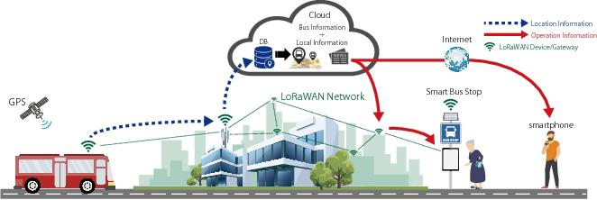
Output

Slide 24
Benefits
Improved efficiency
Accurate passenger load management
Cost saving
Enhanced passenger experience
Reduction in vehicle downtime

Slide 25
Challenges
High initial investment
Interoperability
Cybersecurity risks
Data overload
Scalability issues

Slide 26
Conclusion
In conclusion, IOT-based public transportation optimization holds immense promise for revolutionizing urban mobility.
By harnessing the power of Internet of Things technologies, cities and transportation authorities can unlock a wide array of benefits, including enhanced efficiency, improved passenger experience, reduced congestion, cost savings, and environmental sustainability.
By working together, they can build robust, interconnected systems that leverage real-time data to create safer, more efficient, and sustainable transportation networks.
This approach can lead to more efficient, reliable, and user-friendly public transportation systems.

Slide 27
THANK YOU…

